Slide 1
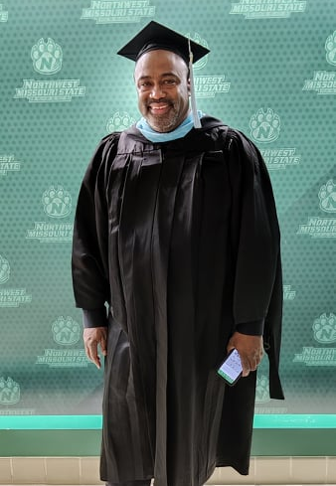
Timothy Tutt Capstone Project
Personal Reflections on the
Eight Functions of Curriculum Leaders,
as Learned from the
Curriculum and Instruction – General Program at Northwest Missouri State University
December 2021

Slide 2
Table of Contents
Slide 3-5: Curriculum and Instruction: 1.5 Years of Learning and Growth
Slides 6-7: Becoming a Leader of Curriculum, Instruction, and Assessment
Slides 8-10: Becoming a Leader of Data Analysis
Slides 11-13: Becoming a Leader of Processes
Slides 14-16: Becoming a Leader of Professional Development
Slides 17-19: Becoming a Leader of Relationship Building
Slides 20-22: Becoming a Leader of Performance
Slides 23-25: Becoming a Leader of Operations
Slides 26-28: Becoming a leader of Change
Slides 29-31: Final Reflections
Slides 32-???: References

Slide 3
Curriculum and Instruction: 1.5 Years of Learning & Growth

Slide 4
Curriculum and Instruction: 1.5 Years of Learning and Growth
June 2020. My 31st year of classroom teaching came to the strangest of ends, as I wrapped up the year teaching students as best as I could, using a format of which I was not familiar, and in a classroom that had been void of children since a contagion rendered classrooms across my district and country unsafe for occupancy three months earlier. I was checking my school e-mail as the academic year came to a bizarre end. I decided to give my spam folder one last check. In it, I found a message from Northwest Missouri State University offering Master’s Degrees online for under $10,000. I was 56 years old at the time, and one year from being able to retire, if I so chose. Not getting a Master’s Degree had always haunted me for many reasons since receiving my B.A. in Spanish in 1988, 33 years ago. I called a number on the e-mail message. I only wanted to ask a few questions. A recently-retired Maryville teacher was at the other end of the phone. We talked for about an hour. I was accepted for enrollment, and was registered for the second summer session of Curriculum and Instruction – General classes by the end of that week. Over the last year-and-a-half, I have taken ten courses to prepare me leadership roles within the educational fields of curriculum and instruction. I just celebrated my 58th birthday a week before submitting this project. What will I do with this degree? Regardless of that outcome, I can honestly say that no matter what else happens, I have interalized 1.5 years of learning and growth – which as been academically challenging, intense, time-consuming (36 credit hours were taken in that 1.5-year time), yet mind- and eye-opening, rewarding, and empowering. No matter what happens, my coursework has led me to become a better more knowledgeable teacher, and a stronger leader within my profession.

Slide 5
Curriculum and Instruction: 1.5 Years of Learning and Growth
In this presentation, I will share highlights of my learnings and take-aways each of the eight Functions of Curriculum Leaders, a set of standards generated and published by the Iowa Association for Supervision and Curriculum Development (Iowa ASCD). After summarizing the understandings I have recalled and gained from each of the functions, I will cite my own coursework as evidence of
how I have applied those learnings in the creation and/or creation of relevant projects and assignment,
how I have analyzed or evaluated information presented or discovered during my research, along with
how I can also apply learnings and take-aways as an educator – in my current classroom practice, or as a curriculum strategist working with building and district leadership.
The presentation will end with reflections on the following questions:
What did I learn from projects and assignments throughout the program?
What was learned from projects and assignments that connects with each function of a curriculum leader?
How has completion of the projects and assignments assisted me in understanding the functions as they relate to me as an educator?
How has the work I completed for projects and assignments contributed to, or lead to, change in professional practice?
What future actions will be taken to ensure continued growth and development in the functions of a curriculum leader?

Slide 6
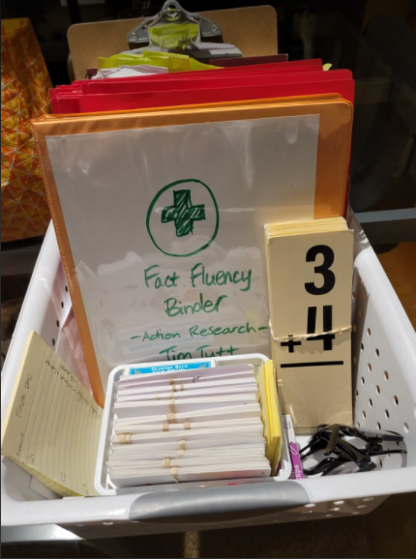
FUNCTION 1: Becoming a Leader of Curriculum, Instruction, and Assessment
Working to assure the capacity of the system and the success of the students is their collaborative leadership in curriculum, instruction, and assessment (Iowa ASCD, 2015, p. 1).
ALIGNED COURSE:
Capstone Seminar (EDUC 61-699)

Slide 7
Becoming a Leader of Curriculum, Instruction, and Assessment
An Overview
Function 1 states that curriculum leaders should “assure the capacity of the system and success of [all] students” by exhibiting “collaborative leadership in curriculum, instruction, and assessment” (Iowa ASCD, 2015, p.1). Curriculum leaders need to make sure that the curriculum, instruction, and assessment at the building or work-site level align with district and/or state standards at every level. As a leader of curriculum, instruction and assessment (CIA) curriculum leaders need to have an understanding of the objectives and standards for each subject at every grade level. Curriculum leaders must have high expectations that both students AND teachers are learning throughout the school year. Curriculum leaders are able to be interpreters of data, meeting with stakeholders to ensure that learning standards and data can be understood and interpreted in ways that drive instruction and student outcomes. They also provide supervision and support to educators to also ensure that teachers are doing their best work. Leaders of curriculum, instruction and assessment are working with others throughout the district to assure that resources – such as time, money, people, and expertise are being allocate.d equitably and accurately

Slide 8
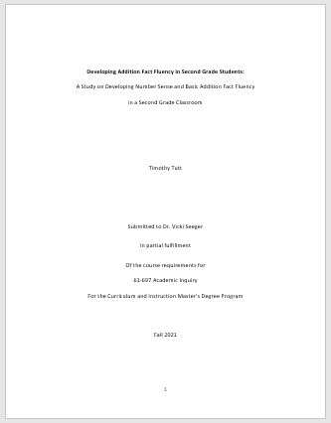
Becoming a Leader of Curriculum, Instruction, and Assessment
Function 1 Coursework:
The Capstone Project (61-699 Capstone Seminar, Module 7)
The most important project of the whole course that has put all of my coursework into perspective has been this very assignment, the Capstone Project. Preparing for its completion led me to the realization that all of the courses align to the eight Functions of a Curriculum Leader. Making that major connection made the work from all the courses have meaning and purpose. There are times when teachers are asked to complete certain tasks. When given those tasks, I often ponder who benefits more, the person giving the task, or our students?
Function 1 focuses on the necessity for curriculum leaders to develop their own capacity to understand the importance of collaboration and facilitation between stakeholders in the development, implementation, and evaluation of curriculum, instruction, and assessment. This Capstone Project is the bow and wrapping of a gift of learning about the many components inside a big box labeled “Master of Science in Education: Curriculum and Instruction components inside.” This Capstone Project is my summary of learnings and take-aways that provide a template for how I proceed as a curriculum leader.

Slide 9
Becoming a Leader of Curriculum, Instruction, and Assessment
Function 1 Coursework:
Functions of a Curriculum Leader (61-653 Trends & Issues in Curriculum & Instruction, Module 4)
The most important project of the whole course that has put all of my coursework into perspective has been this very assignment, the Capstone Project. Preparing for its completion led me to the realization that all of the courses align to the eight Functions of a Curriculum Leader. Making that major connection made the work from all the courses have meaning and purpose. There are times when teachers are asked to complete certain tasks. When given those tasks, I often ponder who benefits more, the person giving the task, or our students?
Function 1 focuses on the necessity for curriculum leaders to develop their own capacity to understand the importance of collaboration and facilitation between stakeholders in the development, implementation, and evaluation of curriculum, instruction, and assessment. This Capstone Project is the bow and wrapping of a gift of learning about the many components inside a big box labeled “Master of Science in Education: Curriculum and Instruction components inside.” This Capstone Project is my summary of learnings and take-aways that provide a template for how I proceed as a curriculum leader.

Slide 10
Becoming a Leader of Curriculum, Instruction, and Assessment
Function x Coursework:
Abc (61-xxx Course, Module x)
Abc
Abc

Slide 11
Becoming a Leader of Curriculum, Instruction, and Assessment
Function x Coursework:
Abc (61-xxx Course, Module x)
Abc
Abc

Slide 12
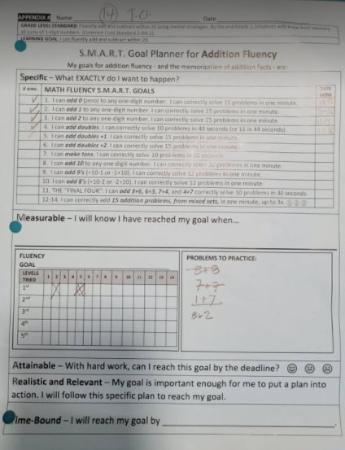
FUNCTION 2: Becoming a Leader of Data Analysis
Working to assure the capacity of the system and the success of the students is their collaborative leadership in use of data to inform, implement, monitor, and evaluate results-based decisions (Iowa ASCD, 2015, p. 2).
ALIGNED COURSES:
Academic Inquiry (EDUC 61-697)
Data Literacy and Assessment (EDUC 61-641)

Slide 13
Becoming a Leader of Data Analysis
An Overview
Function 2 states that curriculum leaders should “use data to inform, implement, monitor, and evaluate results-based decisions” (Iowa ASCD, 2015, p.2).

Slide 14
Becoming a Leader of Data Analysis
Function x Coursework:
Abc (61-xxx Course, Module x)
Abc

Slide 15
Becoming a Leader of Data Analysis
Function x Coursework:
Abc (61-xxx Course, Module x)
The most important project of the whole course that has put all of my coursework into perspective has been this very assignment, the Capstone Project. Preparing for its completion led me to the realization that all of the courses align to the eight Functions of a Curriculum Leader. Making that major connection made the work from all the courses have meaning and purpose. There are times when teachers are asked to complete certain tasks. When given those tasks, I often ponder who benefits more, the person giving the task, or our students?
Function 1 focuses on the necessity for curriculum leaders to develop their own capacity to understand the importance of collaboration and facilitation between stakeholders in the development, implementation, and evaluation of curriculum, instruction, and assessment. This Capstone Project is the bow and wrapping of a gift of learning about the many components inside a big box labeled “Master of Science in Education: Curriculum and Instruction components inside.” This Capstone Project is my summary of learnings and take-aways that provide a template for how I proceed as a curriculum leader.

Slide 16
Becoming a Leader of Data Analysis
Function x Coursework:
Abc (61-xxx Course, Module x)
The most important project of the whole course that has put all of my coursework into perspective has been this very assignment, the Capstone Project. Preparing for its completion led me to the realization that all of the courses align to the eight Functions of a Curriculum Leader. Making that major connection made the work from all the courses have meaning and purpose. There are times when teachers are asked to complete certain tasks. When given those tasks, I often ponder who benefits more, the person giving the task, or our students?
Function 1 focuses on the necessity for curriculum leaders to develop their own capacity to understand the importance of collaboration and facilitation between stakeholders in the development, implementation, and evaluation of curriculum, instruction, and assessment. This Capstone Project is the bow and wrapping of a gift of learning about the many components inside a big box labeled “Master of Science in Education: Curriculum and Instruction components inside.” This Capstone Project is my summary of learnings and take-aways that provide a template for how I proceed as a curriculum leader.

Slide 17
Becoming a Leader of Data Analysis
Function x Coursework:
Abc (61-xxx Course, Module x)
The most important project of the whole course that has put all of my coursework into perspective has been this very assignment, the Capstone Project. Preparing for its completion led me to the realization that all of the courses align to the eight Functions of a Curriculum Leader. Making that major connection made the work from all the courses have meaning and purpose. There are times when teachers are asked to complete certain tasks. When given those tasks, I often ponder who benefits more, the person giving the task, or our students?
Function 1 focuses on the necessity for curriculum leaders to develop their own capacity to understand the importance of collaboration and facilitation between stakeholders in the development, implementation, and evaluation of curriculum, instruction, and assessment. This Capstone Project is the bow and wrapping of a gift of learning about the many components inside a big box labeled “Master of Science in Education: Curriculum and Instruction components inside.” This Capstone Project is my summary of learnings and take-aways that provide a template for how I proceed as a curriculum leader.

Slide 18
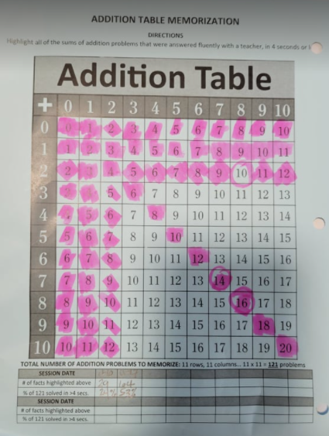
FUNCTION 3: Becoming a Leader of Processes
Working to assure the capacity of the system and the success of the students is their collaborative leadership in establishing and monitoring common practices and procedures to assure alignment and achievement of initiatives and plans with district and building goals (Iowa ASCD, 2015, p. 4).
ALIGNED COURSES:
Trends and Issues in Curriculum & Instruction (EDUC 61-653)
Visionary Leadership (EDUC 61-622)

Slide 19
Becoming a Leader of Processes
An Overview
Function 3 states that curriculum leaders should “assure the capacity of the system and success of the students” by exhibiting “collaborative leadership in curriculum, instruction, and assessment” (Iowa ASCD, 2015, p.4).

Slide 20
Becoming a Leader of Processes
Function x Coursework:
Abc (61-xxx Course, Module x)
Abc
Abc

Slide 21
Becoming a Leader of Processes
Function x Coursework:
Abc (61-xxx Course, Module x)
Abc
Abc

Slide 22
Becoming a Leader of Processes
Function x Coursework:
Abc (61-xxx Course, Module x)
Abc
Abc

Slide 23
Becoming a Leader of Processes
Function x Coursework:
Abc (61-xxx Course, Module x)
Abc
Abc

Slide 24
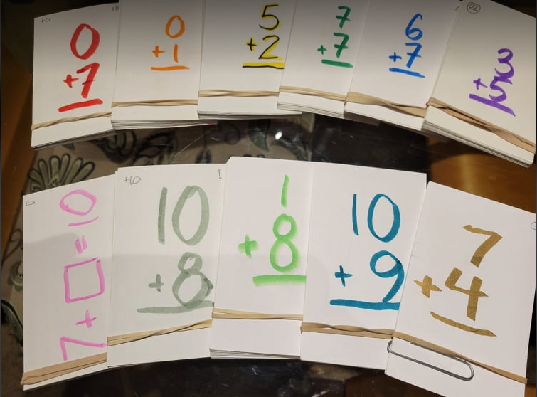
FUNCTION 4: Becoming a Leader of Learning and Professional Development
Working to assure the capacity of the system and the success of the students is their collaborative leadership in modeling, expecting, and monitoring continuous learning (Iowa ASCD, 2015, p. 6).
ALIGNED COURSE:
Trends and Issues in Curriculum & Instruction (EDUC 61-653)

Slide 25
Becoming a Leader of Learning and Professional Development
An Overview
Function 4 states that curriculum leaders should “assure the capacity of the system and success of the students” by exhibiting “collaborative leadership in curriculum, instruction, and assessment” (Iowa ASCD, 2015, p.6).

Slide 26
Becoming a Leader of Learning and Professional Development
Function x Coursework:
Abc (61-xxx Course, Module x)
Abc
Abc

Slide 27
Becoming a Leader of Learning and Professional Development
Function x Coursework:
Abc (61-xxx Course, Module x)
Abc
Abc

Slide 28
Becoming a Leader of Learning and Professional Development
Function x Coursework:
Abc (61-xxx Course, Module x)
Abc
Abc

Slide 29
Becoming a Leader of Learning and Professional Development
Function x Coursework:
Abc (61-xxx Course, Module x)
Abc
Abc

Slide 30
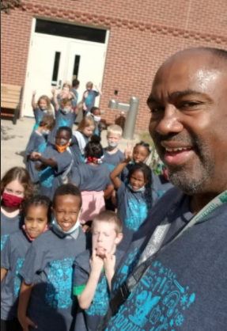
FUNCTION 5: Becoming a Leader of Relationship Building
Working to assure the capacity of the system and the success of the students is the development of relationships of stakeholders focused on student learning (Iowa ASCD, 2015, p. 7).
ALIGNED COURSES:
Culture and Student Engagement (61-606)
Leading in the Digital Age (EDUC 61-689)
Multicultural Education for Diversity, Equity, and Inclusion (EDUC 61-642)

Slide 31
Becoming a Leader of Relationship Building
An Overview
Function 5 states that curriculum leaders should “assure the capacity of the system and success of the students” by exhibiting “collaborative leadership in curriculum, instruction, and assessment” (Iowa ASCD, 2015, p.7).

Slide 32
Becoming a Leader of Relationship Building
Function x Coursework:
Abc (61-xxx Course, Module x)
Abc
Abc

Slide 33
Becoming a Leader of Relationship Building
Function x Coursework:
Abc (61-xxx Course, Module x)
Abc
Abc

Slide 34
Becoming a Leader of Relationship Building
Function x Coursework:
Abc (61-xxx Course, Module x)
Abc
Abc

Slide 35
Becoming a Leader of Relationship Building
Function x Coursework:
Abc (61-xxx Course, Module x)
Abc
Abc

Slide 36
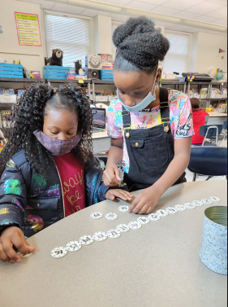
FUNCTION 6: Becoming a Leader of Performance
Working to assure the capacity of the system and the success of the students is to use consistent processes to develop, implement, manage, monitor, evaluate, and communicate the achievement of results-based goals and initiatives informed by data (Iowa ASCD, 2015, p. 9).
ALIGNED COURSE:
Feedback and Goal Setting (EDUC 61-687)

Slide 37
Becoming a Leader of Performance
An Overview
Function 6 states that curriculum leaders should “assure the capacity of the system and success of the students” by exhibiting “collaborative leadership in curriculum, instruction, and assessment” (Iowa ASCD, 2015, p. 9).

Slide 38
Becoming a Leader of Performance
Function x Coursework:
Abc (61-xxx Course, Module x)
Abc
Abc

Slide 39
Becoming a Leader of Performance
Function x Coursework:
Abc (61-xxx Course, Module x)
Abc
Abc

Slide 40
Becoming a Leader of Performance
Function x Coursework:
Abc (61-xxx Course, Module x)
Abc
Abc

Slide 41
Becoming a Leader of Performance
Function x Coursework:
Abc (61-xxx Course, Module x)
Abc
Abc

Slide 42
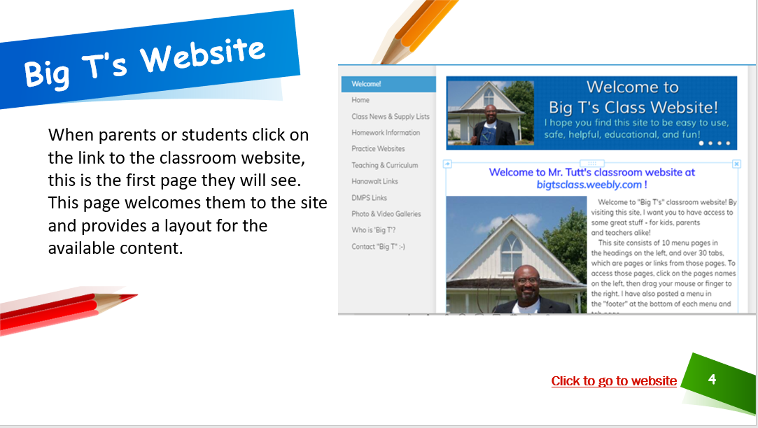
FUNCTION 7: Becoming a Leader of Operations
Working to assure the capacity of the system and the success of the students is their leadership in effectively and efficiently organizing and sustaining resources in the implementation of processes and systems to support teaching, learning, and organizational effectiveness (Iowa ASCD, 2015, p. 10).
Click on this image to see the website I’ve created for my classroom and its stakeholders!
ALIGNED COURSE:
Visionary Leadership (EDUC 61-622)

Slide 43
Becoming a Leader of Operations
An Overview
Function 7 states that curriculum leaders should “assure the capacity of the system and success of the students” by exhibiting “collaborative leadership in curriculum, instruction, and assessment” (Iowa ASCD, 2015, p. 10).

Slide 44
Becoming a Leader of Operations
Function x Coursework:
Abc (61-xxx Course, Module x)
Abc
Abc

Slide 45
Becoming a Leader of Operations
Function x Coursework:
Abc (61-xxx Course, Module x)
Abc
Abc

Slide 46
Becoming a Leader of Operations
Function x Coursework:
Abc (61-xxx Course, Module x)
Abc
Abc

Slide 47
Becoming a Leader of Operations
Function x Coursework:
Abc (61-xxx Course, Module x)
Abc
Abc

Slide 48
FUNCTION 8: Becoming a Leader of Change
Working to assure the capacity of the system and the success of the students is their leadership in effectively and efficiently leading change and developing the capacity of others to deal with the change (Iowa ASCD, 2015, p. 11).
ALIGNED COURSES:
Academic Inquiry (EDUC 61-697)
Change Management in Education (EDUC 61-691)

Slide 49
Becoming a Leader of Change
An Overview
Function 8 states that curriculum leaders should “assure the capacity of the system and success of the students” by exhibiting “collaborative leadership in curriculum, instruction, and assessment” (Iowa ASCD, 2015, p. 11).

Slide 50
Becoming a Leader of Change
Function x Coursework:
Abc (61-xxx Course, Module x)
Abc
Abc

Slide 51
Becoming a Leader of Change
Function x Coursework:
Abc (61-xxx Course, Module x)
Abc
Abc

Slide 52
Becoming a Leader of Change
Function x Coursework:
Abc (61-xxx Course, Module x)
Abc
Abc

Slide 53
Becoming a Leader of Change
Function x Coursework:
Abc (61-xxx Course, Module x)
Abc
Abc

Slide 54
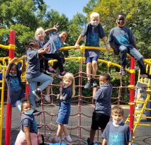
Final Reflections: Self-Analysis, Personal Growth, and Self-Reflection
Abc

Slide 55
Final Reflections: Self-Analysis
What question will I continue to explore? Why is continued growth critical? What reflection will be involved with this question?
Abc

Slide 56
Final Reflections: Personal Growth
What question will I continue to explore? Why is continued growth critical? What reflection will be involved with this question?
Abc

Slide 57
Final Reflections: Looking Ahead
What question will I continue to explore? Why is continued growth critical? What reflection will be involved with this question?
Abc

Slide 58
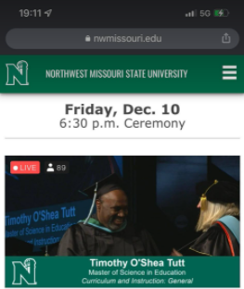
References

Slide 59
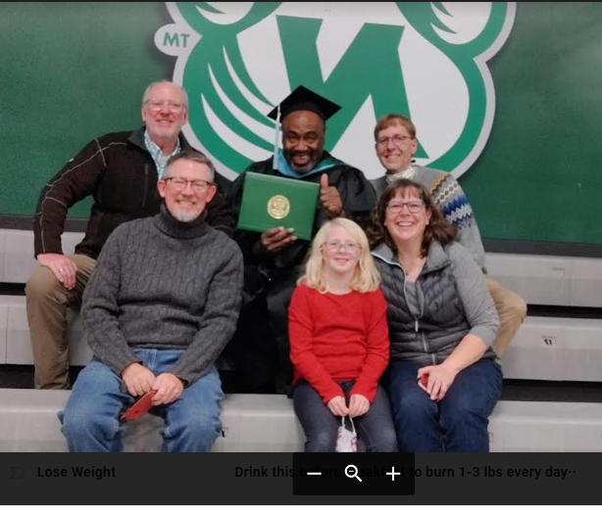
References
Iowa ASCD. (2015, June 12). Functions of curriculum leaders. http://iowaascd.org/index.php/members1/especially-you/central-office-functions-our-work
Iowa ASCD. (2022). Resources: 8 functions of highly effective curriculum leaders. http://iowaascd.org/index.php/events/2021-curriculum-leadership-academy/resources-8-functions-highly-effective-curriculum-lead/

