Slide 1
Module 4 Assignment – Providing Feedback
Timothy O. Tutt
Department of Curriculum and Instruction: Master’s Program
Northwest Missouri State University
61687 – 87 Feedback and Goal Setting
Fall 2020, Block 2
Dr. Corinne Arens
November 17, 2020

Slide 2
Table of Contents
SLIDE 3: The Standard
SLIDE 4: The Success Criteria
SLIDE 5: The Assessment
SLIDE 6: The Feedback, Explained
SLIDE 7: 1-on-1: Gavin
SLIDE 8: 1-on-1: Senit
SLIDE 9: 1-on-1: Owen
SLIDE 10: 1-on-1: Louie
SLIDE 11: Self-Feedback (My Reflection)
SLIDE 12: References
SLIDE 13: Closing Slide

Slide 3
The Standard
Draw a picture graph and bar graph (with a single-unit scale) to represent a data set with up to four categories. Solve simple put-together, take-apart, and compare problems using information presented in a bar graph (Iowa and National Core Standard 2.MD.10).
On Thursday, Nov. 12, the students completed a summative assignment that showed their independent understanding of the following standard:

Slide 4
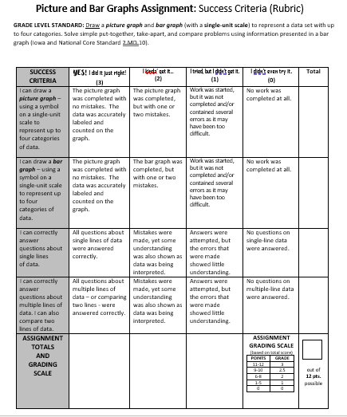
The Success Criteria
On Friday, November 6, the standard was previously broken down and explained to the students.
(A video clip of that lesson was submitted as part of the Module 3 assignment.)
Each of the primary menu tabs contain embedded multiple related tabs.

Slide 5
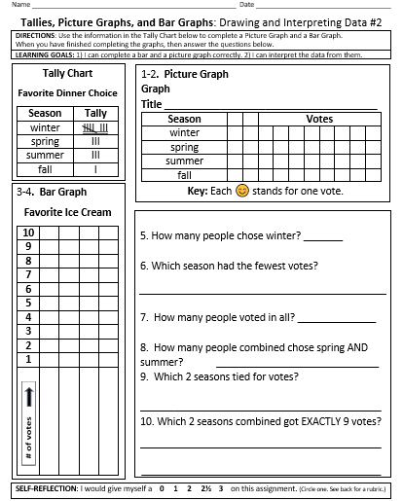
The Assessment
This is the assignment given to the class on Friday, November 13. I re-created a similar assignment meant to be summative from their math book.
I included two learning goals at the top of the sheet. I also included a space for a student self-reflection at the bottom of the document.
The Success Criteria, repeatedly used throughout this week’s work on the core standard, was printed on back.

Slide 6
The Feedback, Explained
When offering feedback, I followed these five tips below which I have paraphrased from Marianne Stenger’s “5 Research-Based Tips for Providing Students with Meaningful Feedback” (2014):
1. Be specific.
2. Be timely.
3. Make sure the student is involved in the feedback process.
4. Know your students. Use your words well with them.
5. Set goals WITH each student… not FOR them.

Slide 7
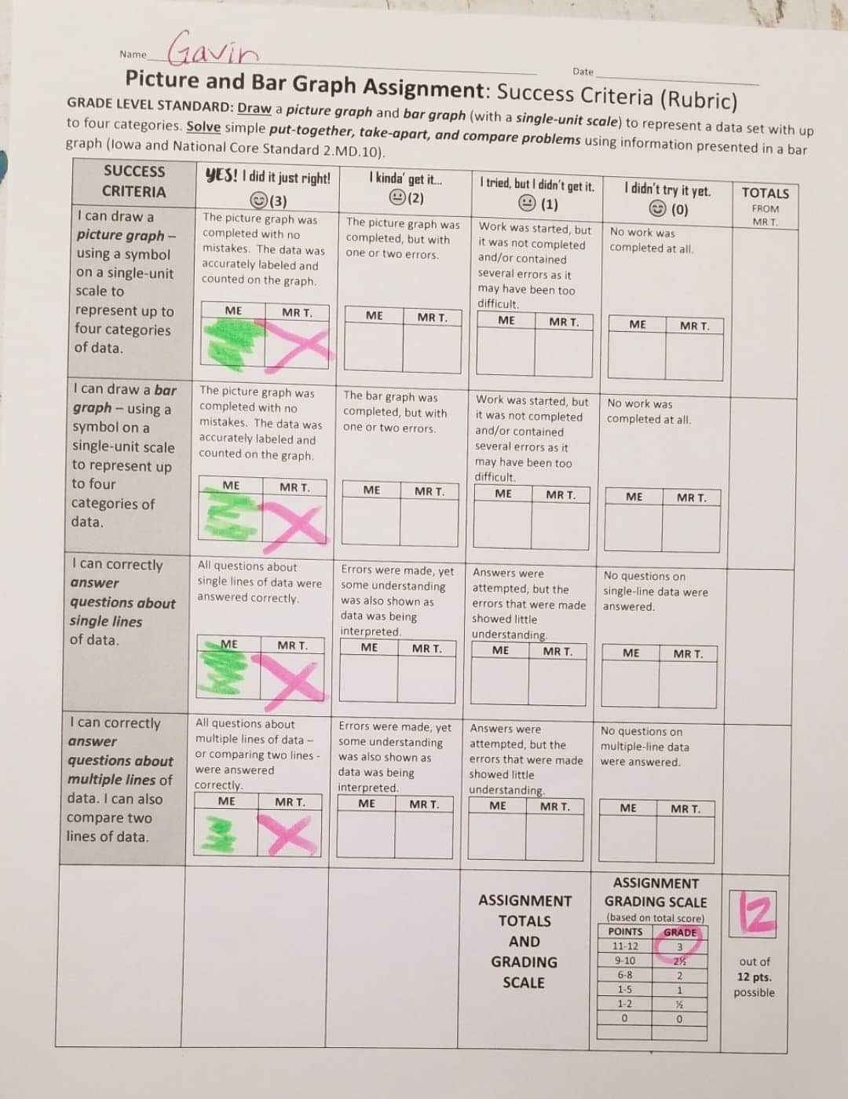
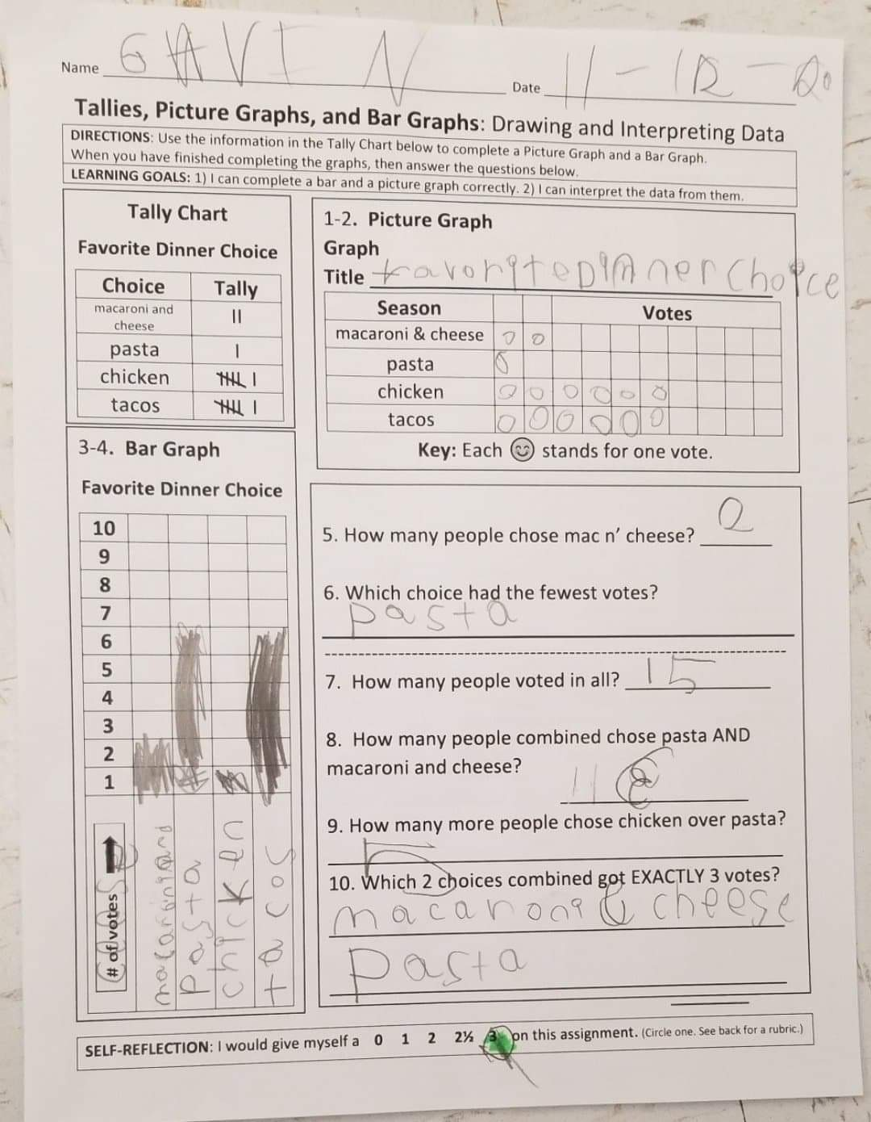
1-on-1 Feedback: Gavin
Gavin’s Feedback Session (11-13-20)
Video clips will be sent separately.
Gavin is a very active student whose mind and body are constantly moving. He loved the personal attention he received during feedback and was engaged!

Slide 8
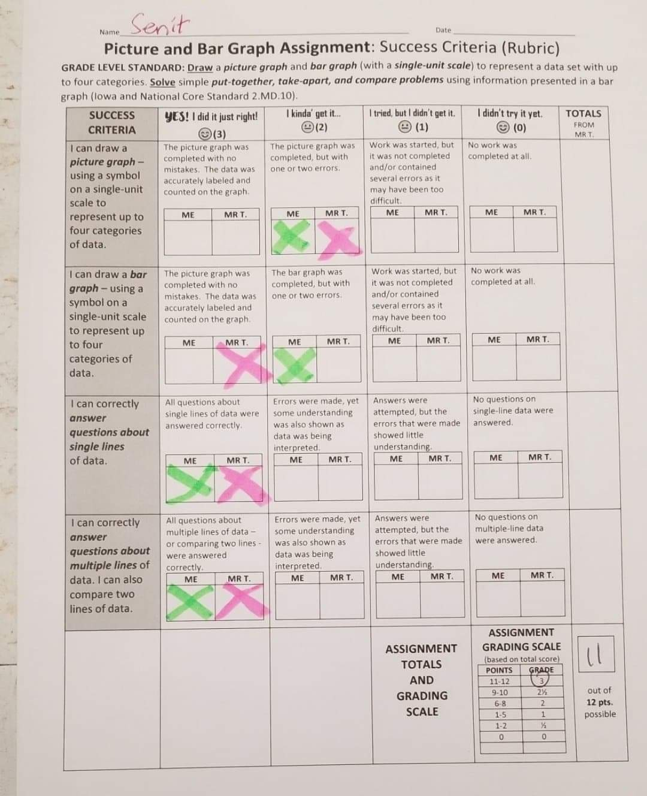
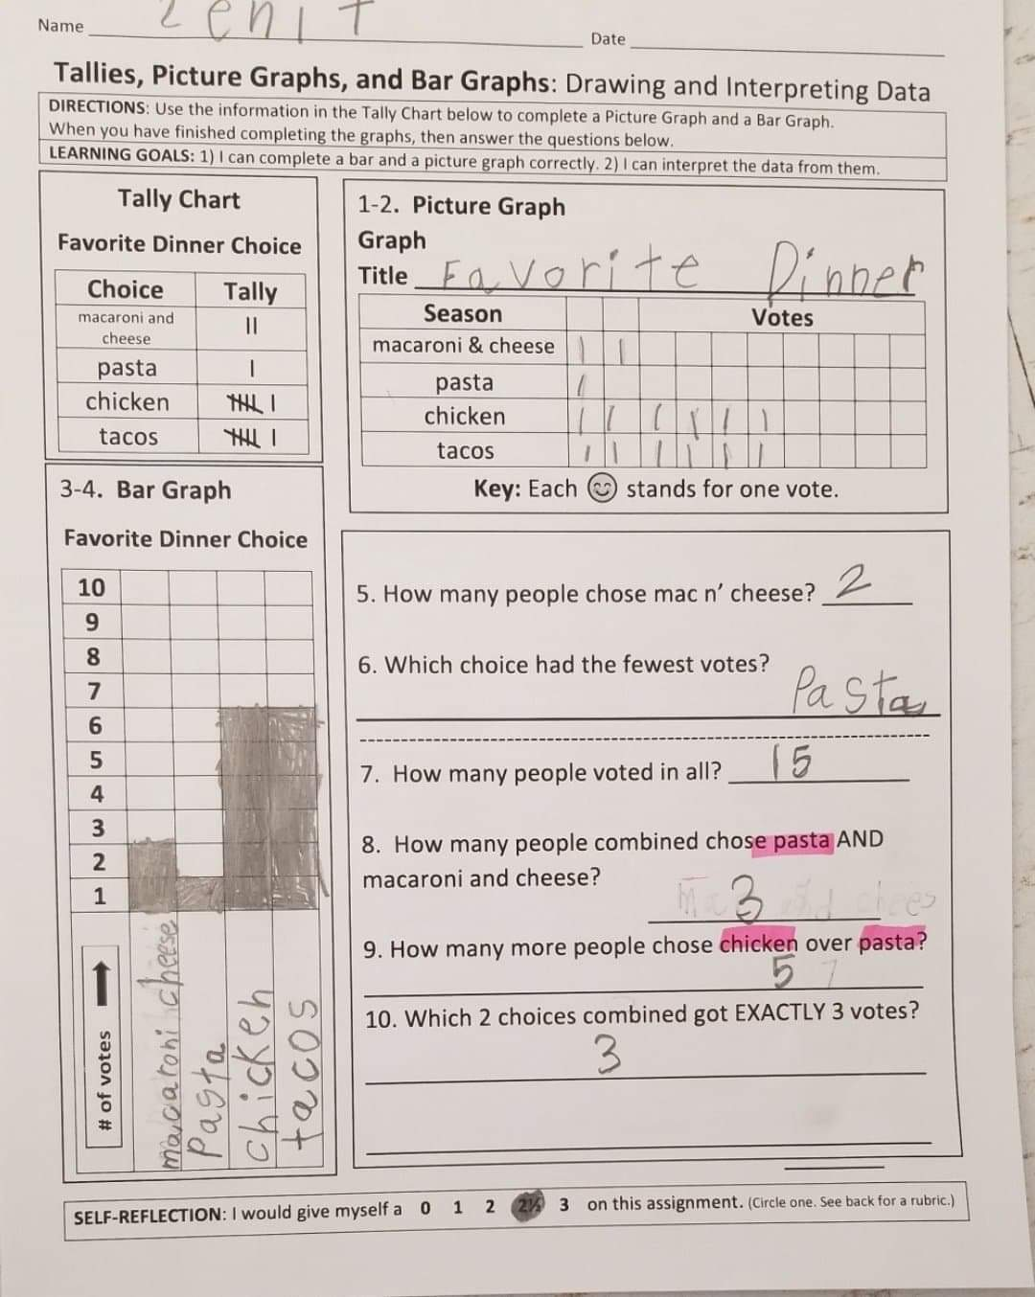
1-on-1 Feedback: Senit
Senit’s Feedback Session (11-13-20)
Video clips will be sent separately.
Senit is a student who sometimes struggles with the English language, but is determined to learn. This one-on-one time was valuable for her!

Slide 9
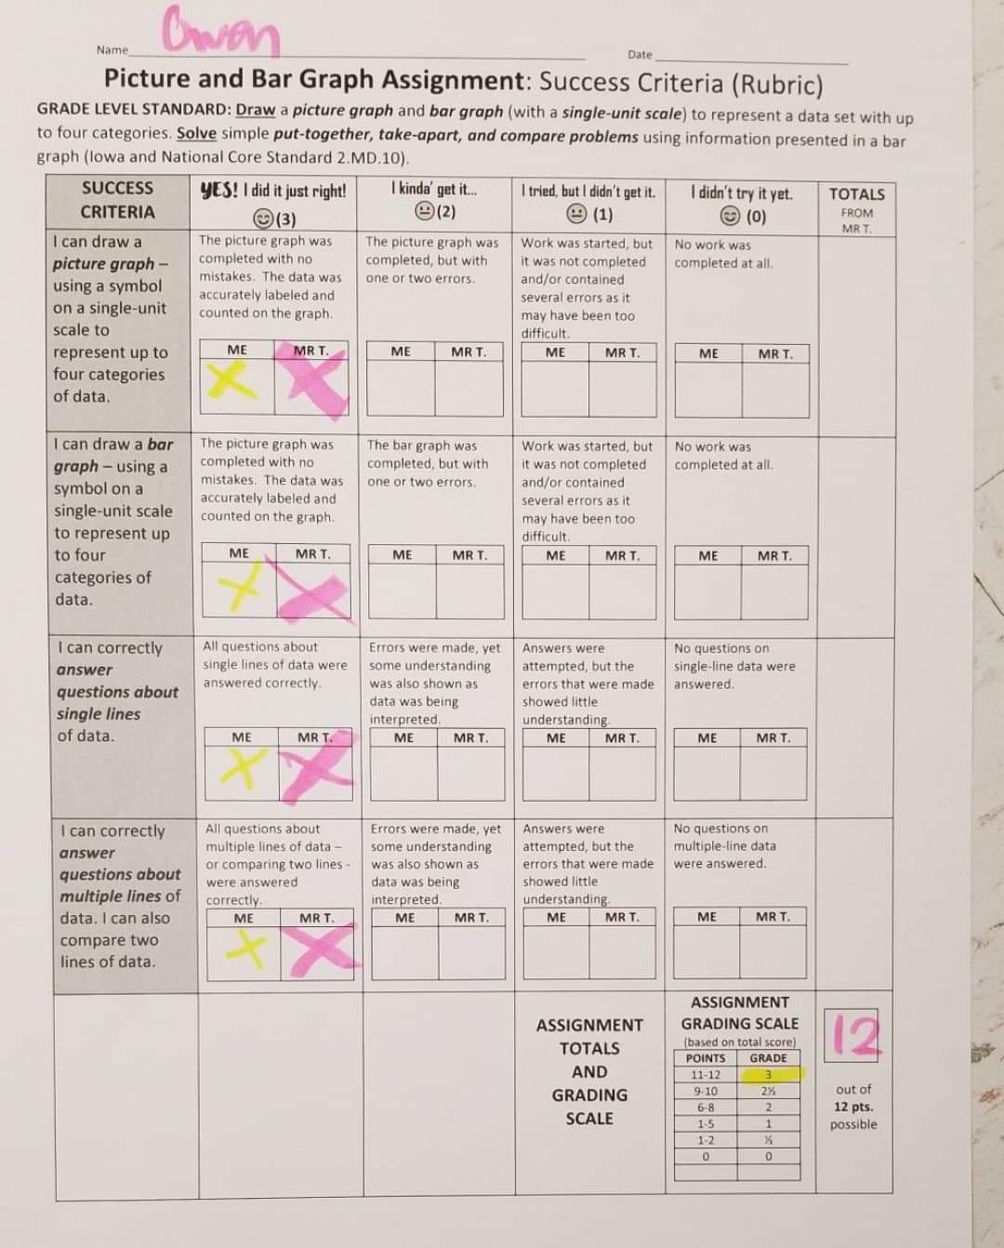
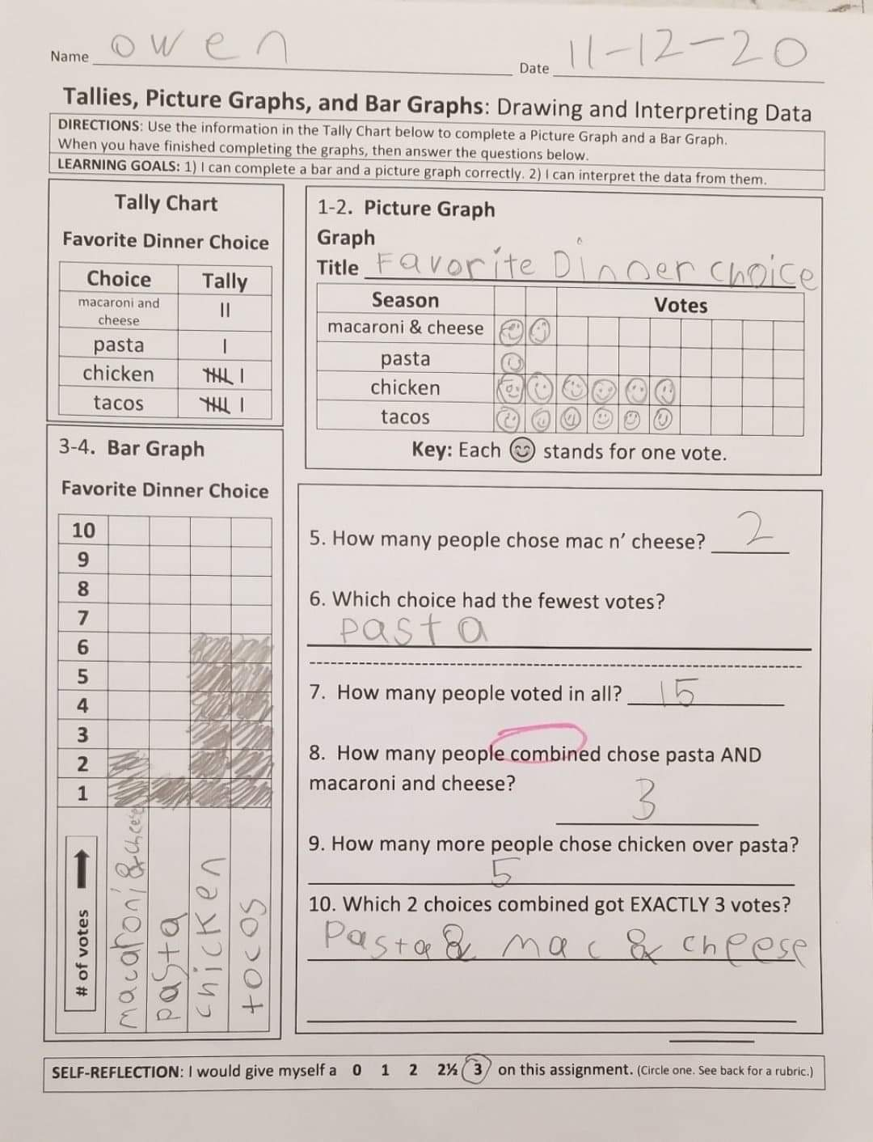
1-on-1 Feedback: Owen
Owen’s Feedback Session (11-13-20)
Video clips will be sent separately.
Owen soaks up knowledge like a sponge, and always wants to learn more. He is wanting to learn more about graphing, and taking this skill to new levels!

Slide 10
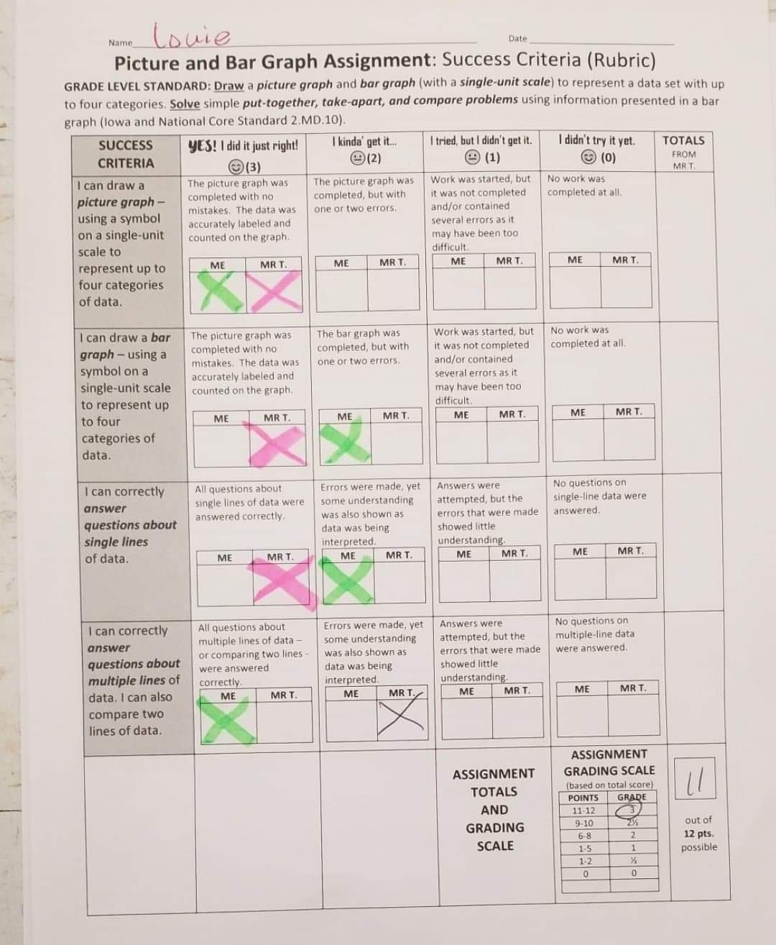
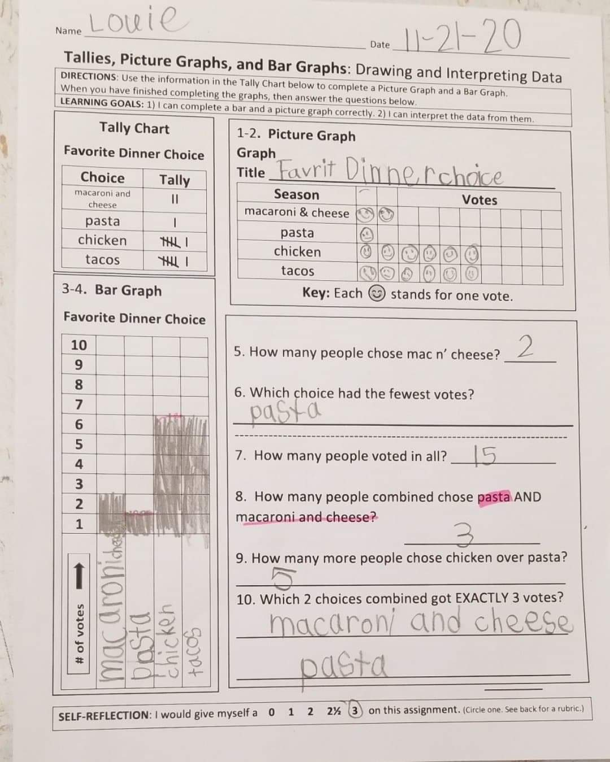
1-on-1 Feedback: Louie
Louie’s Feedback Session (11-13-20)
Video clips will be sent separately.
Louie is a timid student who struggles often. However, in getting to know Louie, I have learned how badly he wants to be successful. This feedback helps him a lot!

Slide 11
Self-Feedback (My Reflections)
Throughout the week of learning about graphing, I offered quick snippets of specific verbal feedback as I’d walk around the room checking their work. They had also seen the success criteria which was the same throughout the week. Students had been alerted that I wanted to have one-n-one feedback sessions at the end of the week with each one of them, so they were prepared.
I am very content with how my one-on-one feedback sessions turned out. I had engaging conversations with each and every student. Students wanted to know when their “turn” was coming. Using this one-on-one strategy also reminds me of the importance of relationship building in making feedback effective and meaningful.
However, this type of feedback was very time-consuming. It worked quite nicely with a hybrid class with only half of the the students in attendance on a given day. Yet, I will add this technique of giving feedback to my portfolio of feedback ideas, and will utilize this strategy to help assess progress on key standards throughout the year.

Slide 12
References
Brookhart, S. (2012). Feedback for learning. Educational Leadership, 70(1), 24-29.
Triumphlearning. (2015, October 31). Characteristics of Effective Feedback. Retrieved November 07, 2020, from https://www.youtube.com/watch?v=ieJrycEuE6o
Ruiz-Primo, M. A., & Brookhart, S. M. (2018). Using feedback to improve learning. New York, NY: Routledge.
Stenger, M. (2014, August 06). 5 Research-Based Tips for Providing Students with Meaningful Feedback. Retrieved November 02, 2020, from https://www.edutopia.org/blog/tips-providing-students-meaningful-feedback-marianne-stenger

Slide 13
November 2020
Thank you for your time and feedback! ☺
61687-87
Feedback and Goal Setting

